Slide 1
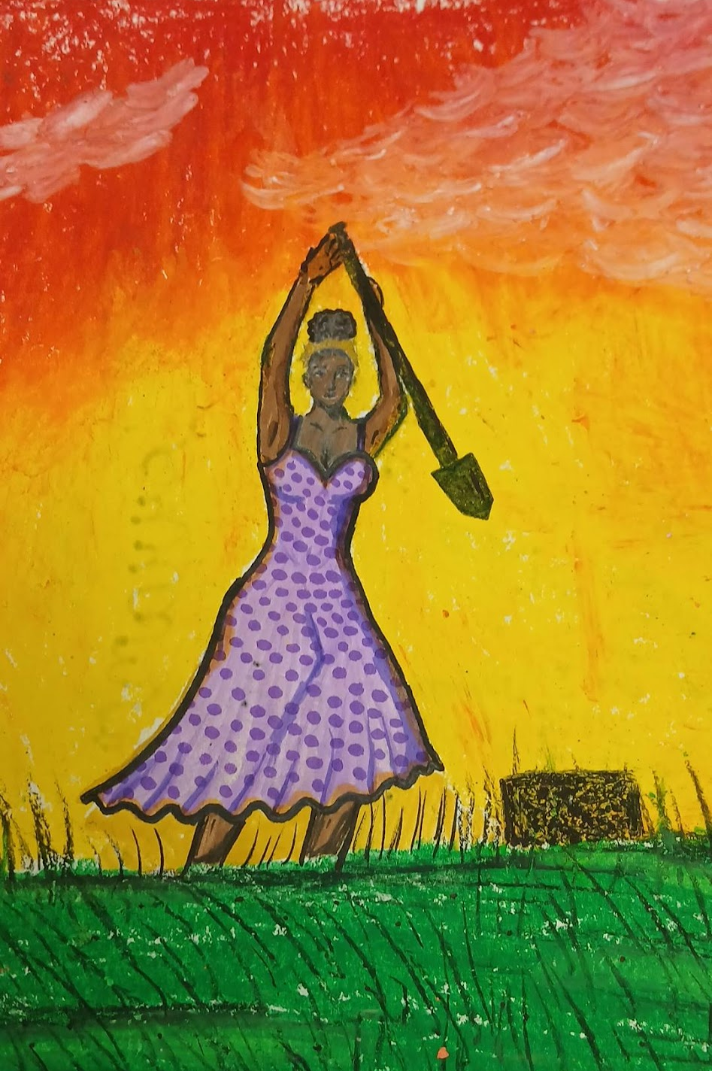
Recreating
Artwork
8th Grade ELA

Slide 2
Description
This interdisciplinary 8th grade ELA and arts integration project allowed students to research South Carolina artists Alvin Glen and William Henry Johnson while exploring culture, history, and identity. Students created “Stamp of Honor” portraits, recreated famous artworks using the artists’ styles and techniques, and analyzed symbolism, color, and artistic choices. Through research, collaboration, and creative expression, students strengthened literacy, critical thinking, and visual arts skills while making meaningful connections to South Carolina history and culture.

Slide 3
Standards
ELA Standards:
8.IQ.1 – Formulate questions, gather information, and evaluate sources.
8.RI.1–8.RI.6 – Analyze central ideas, author’s purpose, and supporting details in informational texts.
8.W.2 – Write informative/explanatory texts
8.W.4 – Develop and strengthen writing through planning and revision.
8.C.1 – Interact appropriately in collaborative discussions
8.C.3 – Present information and ideas clearly.
Visual Arts Standards:
VA.CR.NL.1 – Generate and conceptualize artistic ideas
VA.CR.NL.2 – Organize and develop artistic work.
VA.PR.NL.1 – Analyze and present artistic work.
VA.RE.NL.1 – Perceive and analyze artistic work
VA.RE.NL.2 – Interpret meaning in artistic work.
VA.CN.NL1 – Relate artistic ideas and works with societal, cultural, and historical context.

Slide 4

Connection to Strategic Plan
Goal 1, Objective 1.2
Art integration lessons are omnipresent, connecting ELA, history, research, and visual arts.
Goal 1, Objective 1.2(d)
Students completed reflections and discussions on learning through core subjects and the arts.
Goal 1, Objective 1.2(b)
A STEAM experience that increases student engagement and depth of knowledge.
Goal 3, Objective 3.1
Encourages accessible arts experiences through hands-on creation and collaboration.
Goal 4, Objective 4.1
Connects students to local SC artists, strengthening links to culture and community.
Goal 4, Objective 4.2
Promotes appreciation of student work through displays and visual documentation.

Slide 5
Connection to Philosophical Framework
Defining Culture
Defining School and Community Culture Through the Arts
Students explored the artwork and stories of South Carolina artists, helping build appreciation for the cultural identity and artistic heritage of the Pee Dee region and the state.
Defining School and Community Culture Through the Arts
Students explored the artwork and stories of South Carolina artists, helping build appreciation for the cultural identity and artistic heritage of the Pee Dee region and the state.
Honoring Diverse Voices and Perspectives
The project highlighted artists from diverse backgrounds and encouraged students to recognize how art reflects personal experiences, traditions, and community history.
Building a Culture of Creativity and Expression
Students engaged in creative risk-taking, artistic exploration, and personal interpretation, helping foster a school culture that values imagination and student voice.
Promoting Pride in Local and State Arts Communities
The project strengthened student awareness of South Carolina’s artistic contributions and encouraged pride in the community’s cultural and creative accomplishments.
Connecting Students to Cultural Traditions and Identity
By analyzing symbolism, storytelling, and artistic themes, students developed a deeper understanding of how the arts preserve culture and communicate identity across generations.

Slide 6

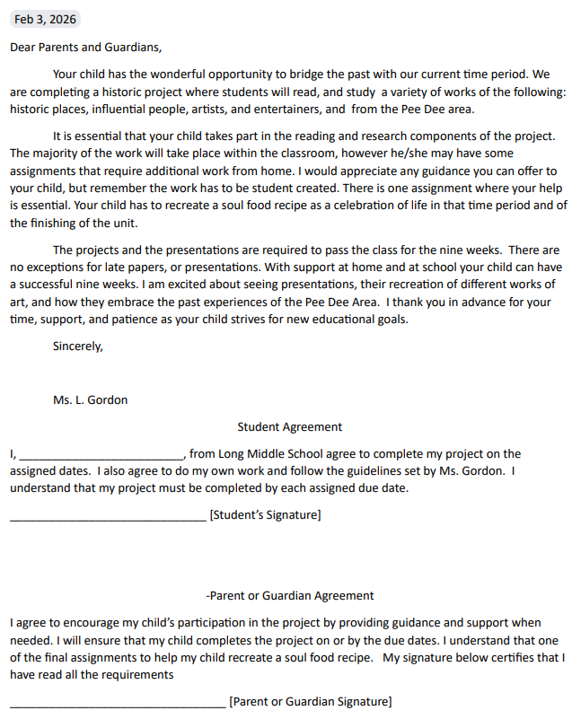
150,000
Letter to Parents
Big numbers catch your audience’s attention

Slide 7
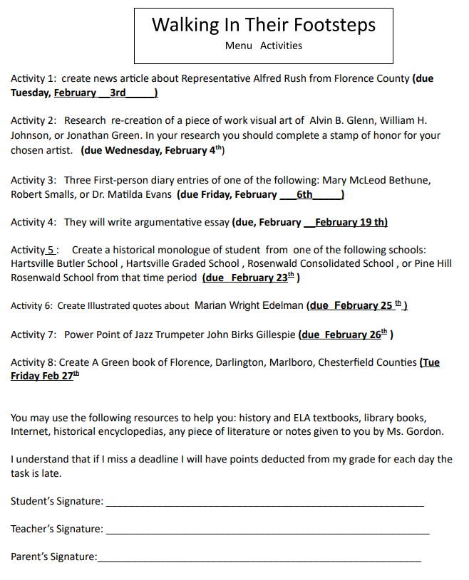
The Assignment Information Sheet and Contract
150,000
Big numbers catch your audience’s attention

Slide 8
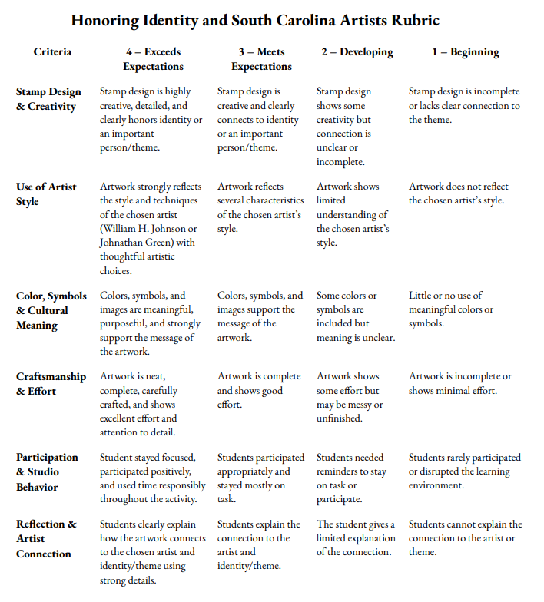
150,000
The Rubric
Big numbers catch your audience’s attention

Slide 9
Resources Given to Students
William Henry Johnson
Art and Bio https://thejohnsoncollection.org/william-h-johnson/
Biography from his home town https://www.flocomuseum.org/about-william-h-johnson/william-h-johnson-biography-p2/
William Henry Johnson gallery https://www.moma.org/artists/22989-william-h-johnson#works
Alvin Glen About the Artist https://myemail.constantcontact.com/Alvin-B--Glen--2014-Poster-Artist---Juried-Art-Exhibition-Opening-Reception.html?soid=1101658999868&aid=q7tI3WBt-qA#:~:text=ABOUT%20THE%20ARTIST%3A%20A%20native,State%20University%20to%20study%20music.
Alvin Glen Gallery https://www.alvinglen.com/works
Artist posting his work https://youtu.be/FZ5KP5LSymc?si=JwPgq19DjknDeyUX

Slide 10
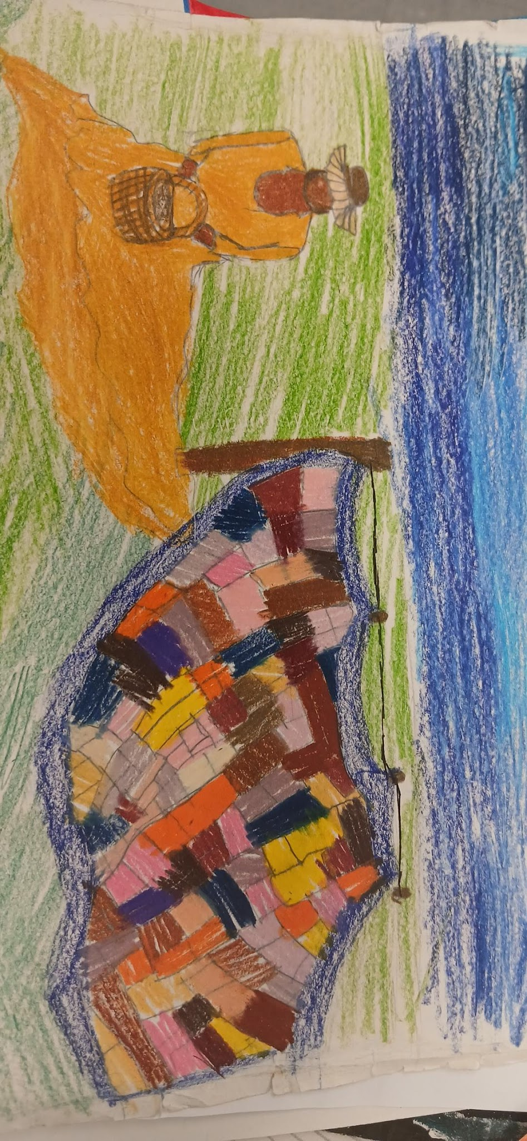
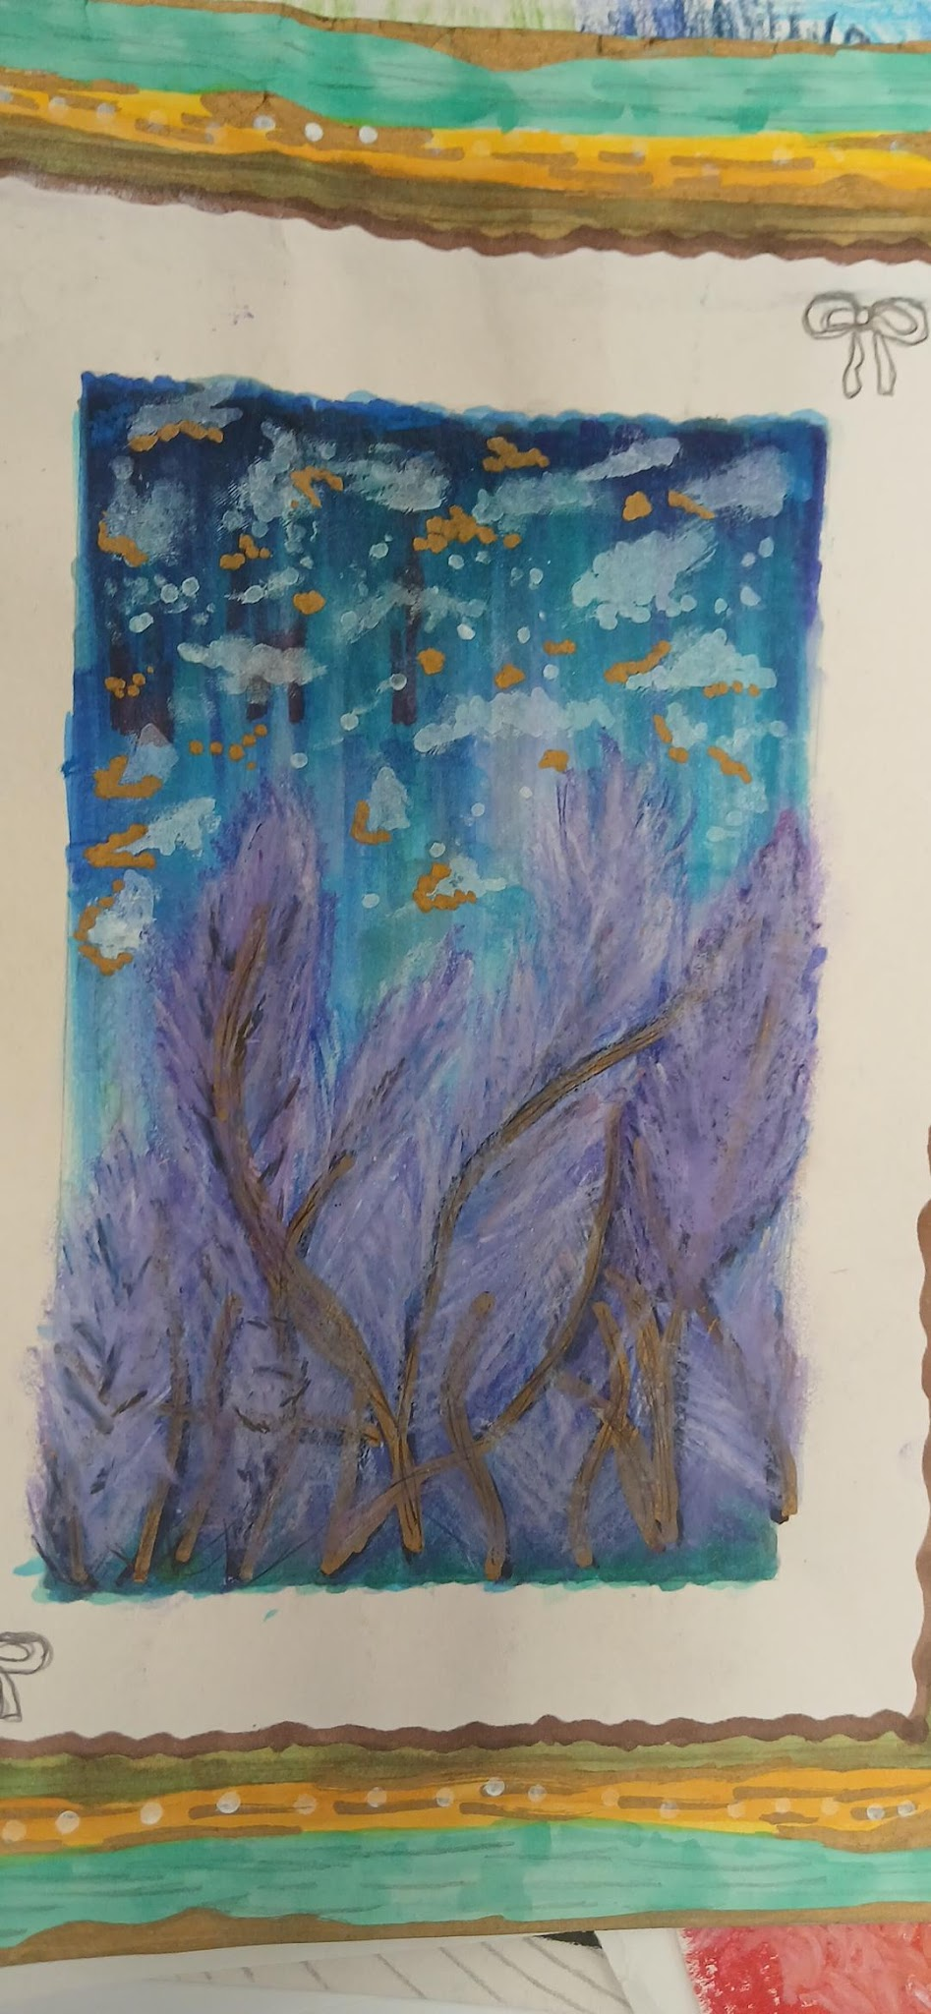
Student Work

Slide 11
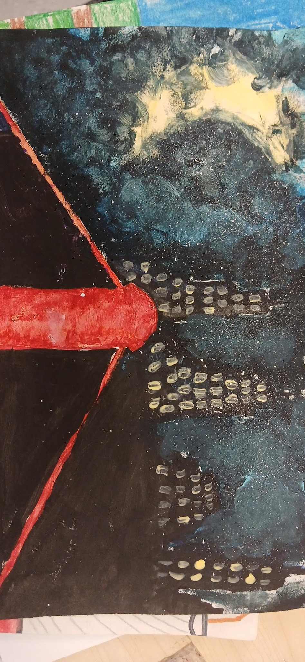
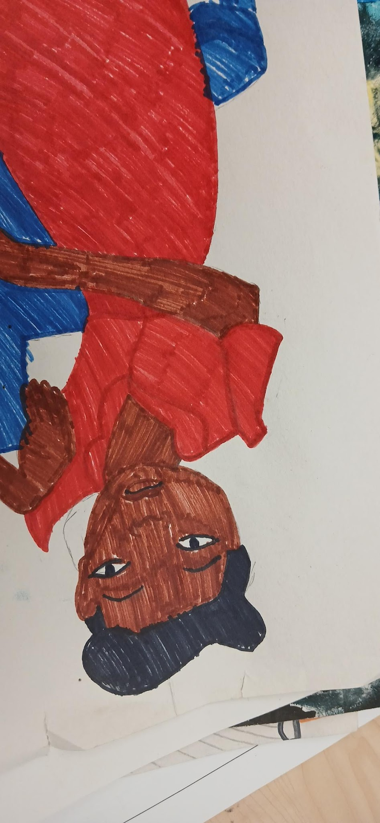
Student Work

Slide 12
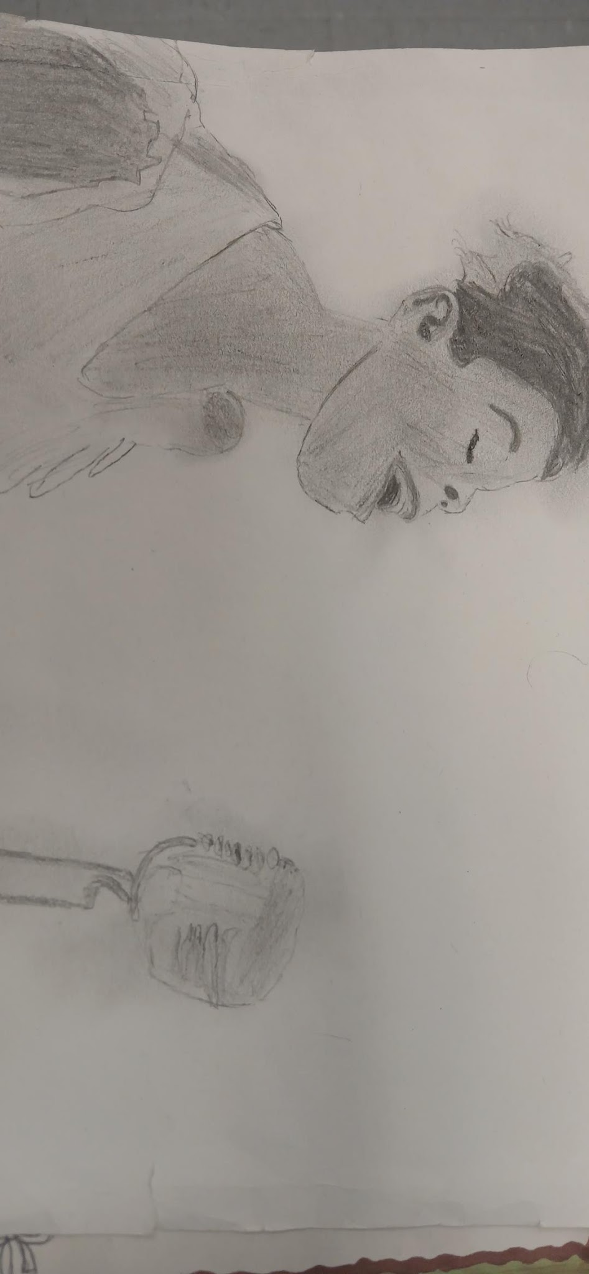
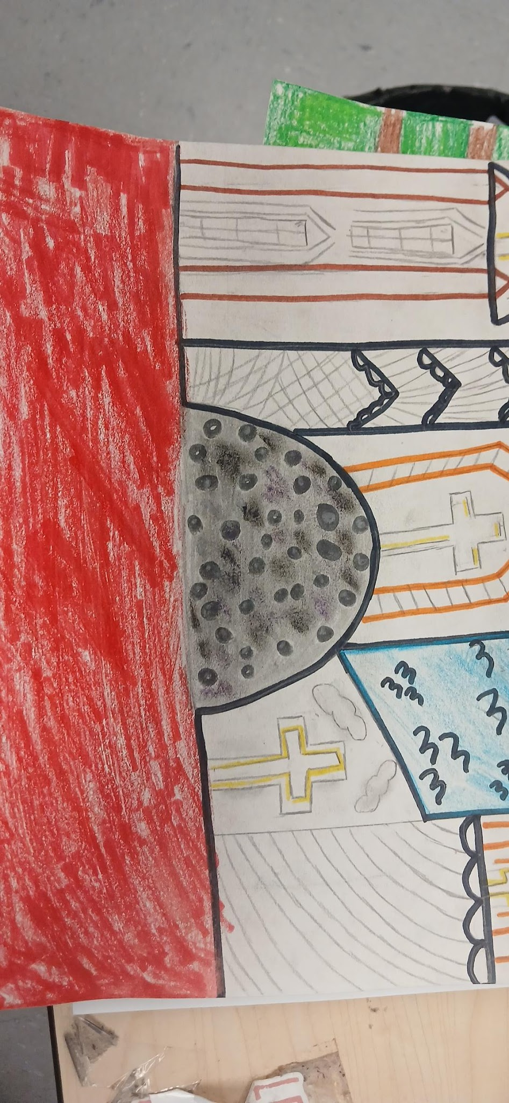
Student Work

Slide 13
Teacher Reflection
8th grade students researched South Carolina artists Alvin Glen and William Henry Johnson. From their research they completed a stamp of honor where they drew a portrait of the artist and provided details of their life. Next they moved on to recreate the works from the artist. It was welcoming to see the students strive for excellence. Some students chose the art they felt easier to recreate, while others welcomed the challenge of blending the colorful hues. In their works they critiqued and questioned each other about their artistic decisions. They proudly showcased their work and asked if we could do something like that again.

Slide 14
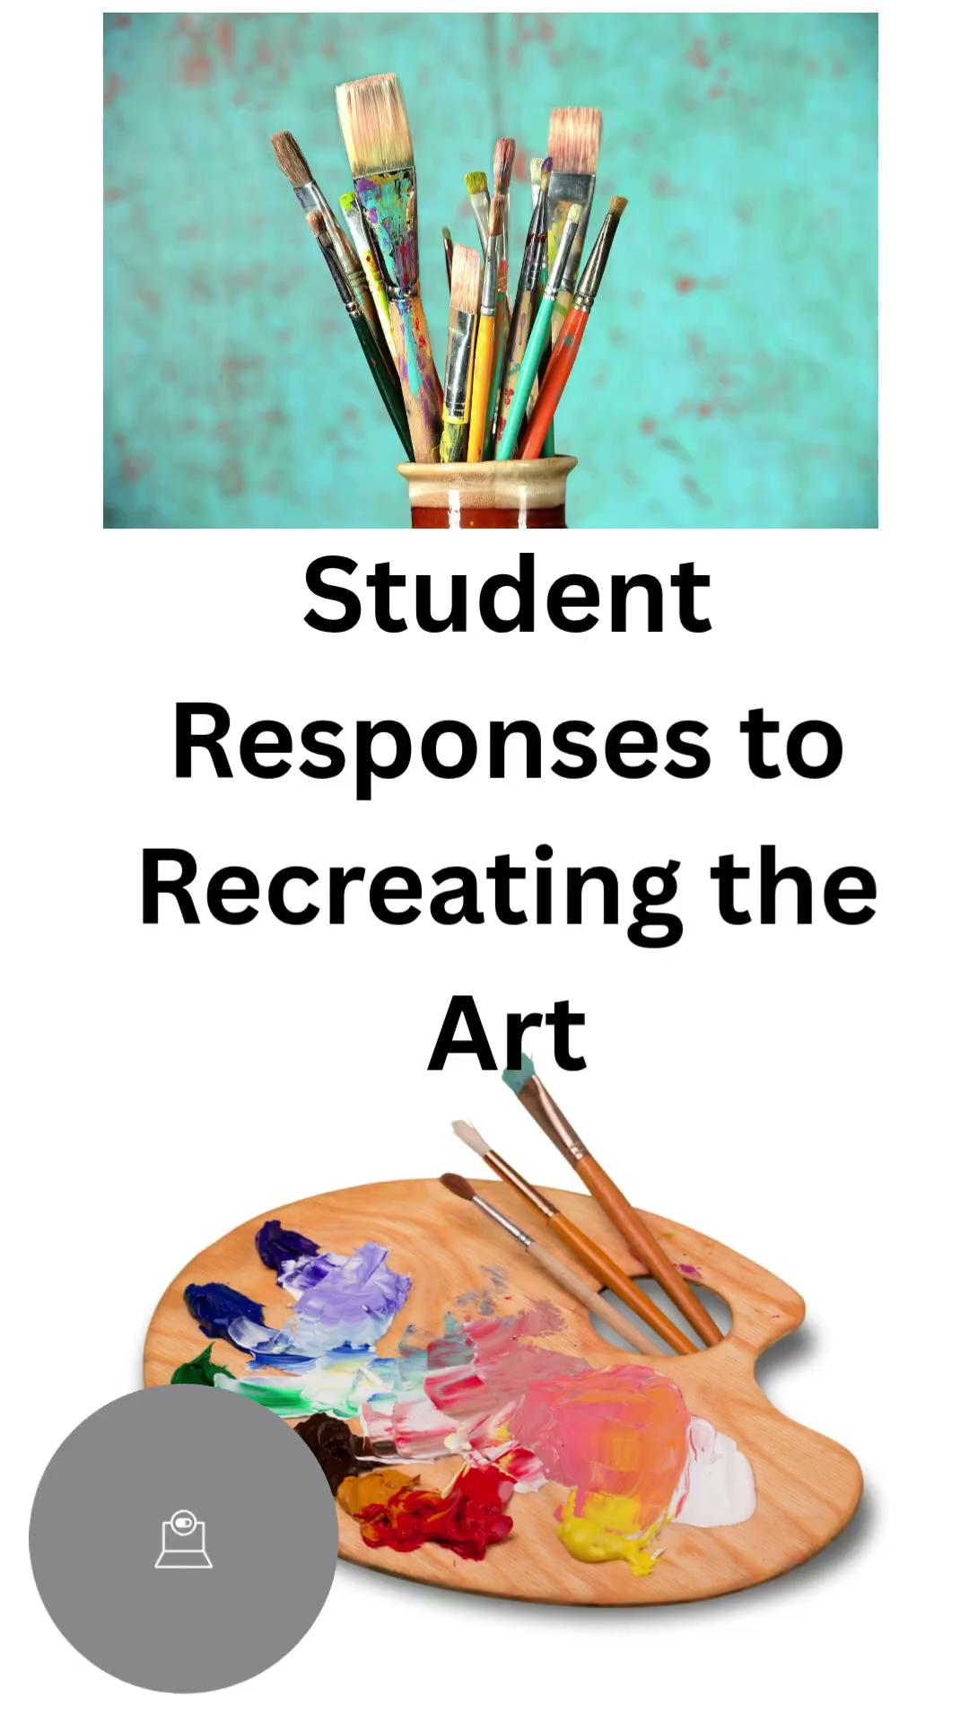
Student Reflection Interviews
https://canva.link/iwlzqa3271jgm7c

