Slide 1
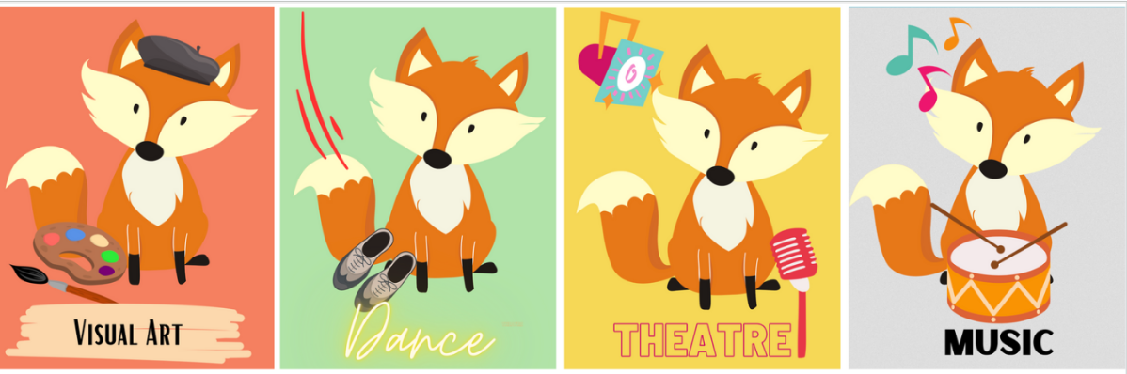
HE Bonner Elementary School
2025-2026

Slide 2
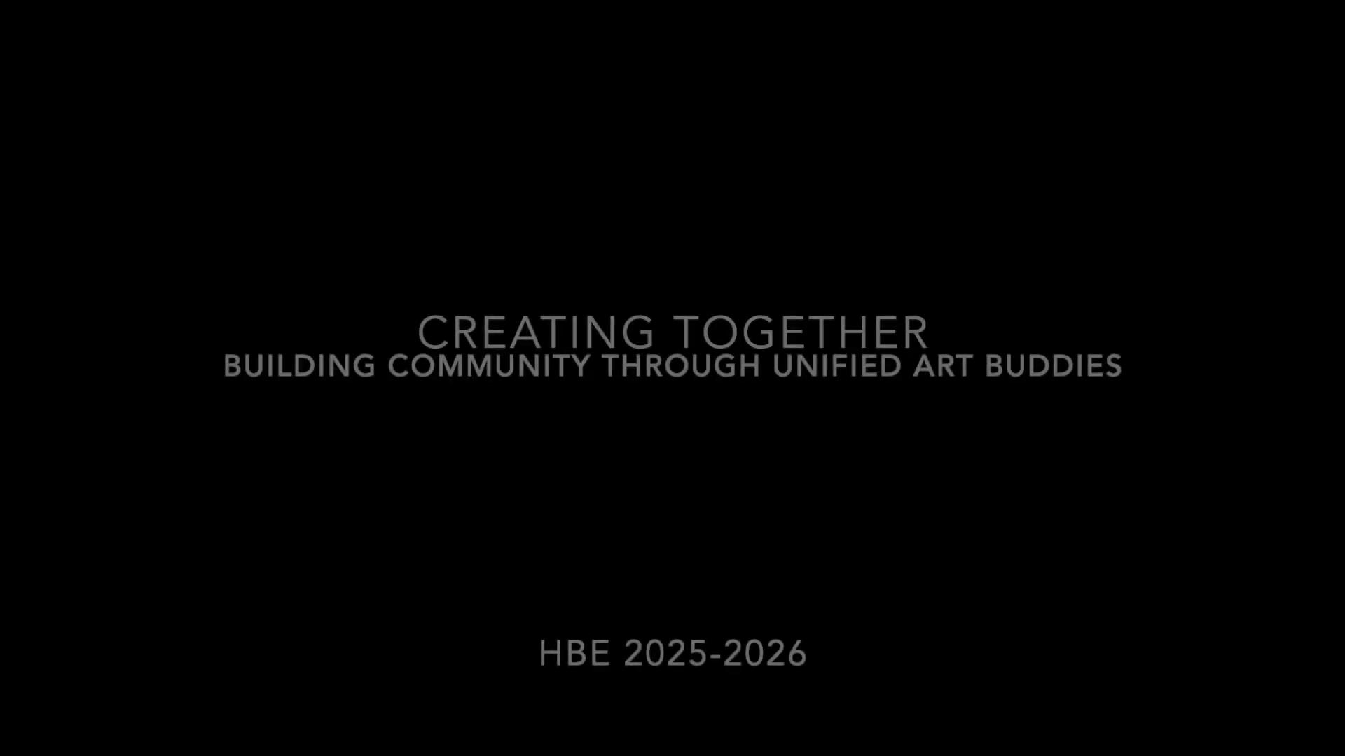
Creating Together:
Building Community Through Unified Art Buddies
2025-2026
After years of planning and dedication, H.E. Bonner finally launched its Peer Buddies program in the Visual Art classroom during the 2025-2026 school year. What began as a vision back in 2019-2020 has become a reality—a thoughtfully designed initiative to integrate peer support into our self-contained, modified art classroom. This program serves students whose Least Restrictive Environment (LRE) is best supported through a specialized, separate art class rather than the mainstream art setting. By pairing peer buddies with our students, we've created a collaborative learning environment that fosters meaningful connections, peer mentorship, and inclusive artistic growth. Starting in January 2026, our Visual Art Peer Buddies program has already begun transforming our classroom culture—building community, enhancing student engagement, and creating authentic opportunities for all learners to thrive together through creative expression.

Slide 3
Creating Together:
Building Community Through Unified Art Buddies
2025-2026
Strategic Arts Plan
Arts Education Goal Statement: Strengthen Arts curriculum and instruction for all students to improve achievement in the Arts over the next three years
Objective 2 of 3: Continue supporting the Arts Program for students with exceptionalities and pre-kindergarten students over the next three years
Action Step C. C. Continue implementing classroom peer support in our unified arts classes through the Renaissance Team, building on the visual art initiative started in the 2025-2026 school year
** Action step represents SAP FY27-29, showing the continuation of this goal
Philosophy Connection
This artifact demonstrates our commitment to defining an inclusive arts culture. We believe in arts for all and arts education delivered in appropriate and accessible way. Our peer buddy program exemplifies this value by providing all students access to the visual art curriculum, allowing them to create alongside their peers and build meaningful connections. This innovative embodies our school culture of arts for all.
Standards Connections
VA.CR.NL.1 – I can name and use some of the elements of art to express ideas
VA.CR.NL.1.1 – I can use elements of art to communicate a story.
VA.CR.NL.1.2 – I can select elements of art to construct two-dimensional or three-dimensional artwork.
Profile of a South Carolina Graduate: World Class Skill- Collaboration and teamwork
We believe this artifact demonstrates our commitment to reaching all students in visual art and meeting rigorous academic standards in a modified setting. Beyond academics, this initiative exemplifies the world-class skills outlined in the Profile of the South Carolina Graduate—fostering collaboration, communication, creativity, and critical thinking through authentic peer partnerships and inclusive artistic practice.

